Slide 1

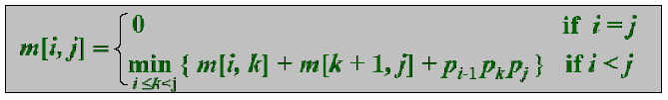
Simple Review
Assembly-line scheduling
  f * = min( f₁[n] + x₁, f₂ [n]+x₂)
Matrix-chain multiplication

Slide 2
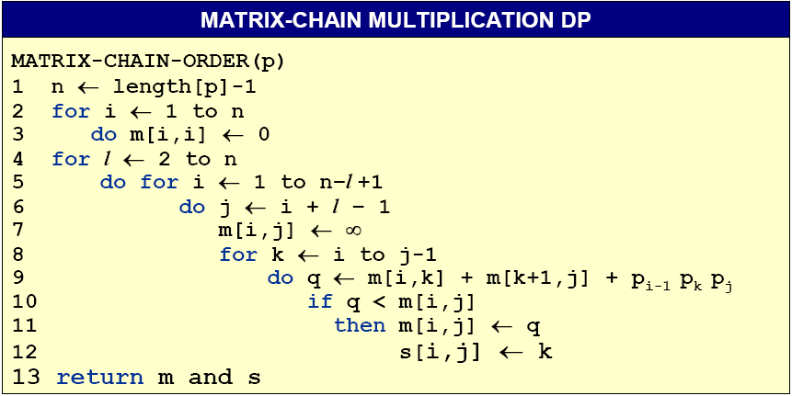
Matrix-Chain Multiplication DP Algo.
O(n³)

Slide 3
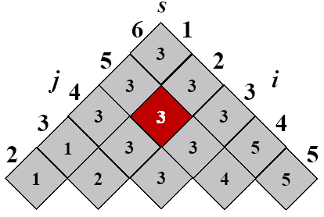
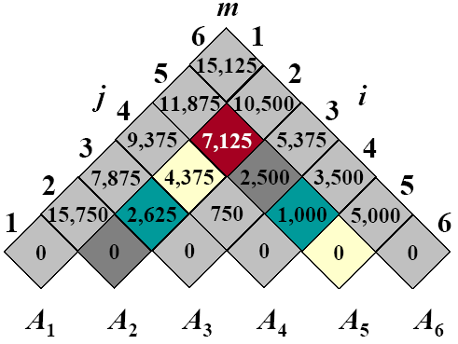
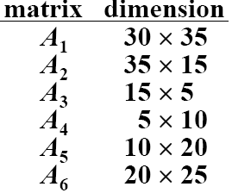
Example: DP for MCM
The optimal solution is ((A₁(A₂A₃))((A₄A₅)A₆)
Notes:
m[2,5]
m[2,2] + m[3,5] + 35*15*20 = 0 + 2500 + 10500 = 13000
m[2,3] + m[4,5] + 35*5*20 = 2625 + 1000 + 3500 = 7125
m[2,4] + m[5,5] + 35*10*20 = 4375 + 0 + 7000 = 11375

Slide 4
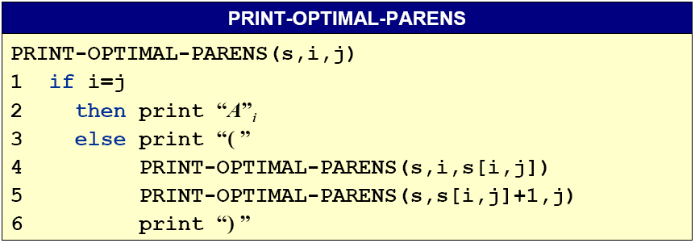
Construct an Optimal Solution
The final matrix multiplication in computing A_{1..n} optimally is A_{1..s[1,n]}A_{s[1,n]+1..n}. s[1,s[1,n]] determines the last matrix multiplication in computing A_{1..s[1,n]} and s[s[1,n]+1,n] determines the last matrix multiplication in computing A_{s[1,n]+1..n}.

Slide 5
Homework
15.1-1, 15.2-1

Slide 6
Design and Analysis of Algorithms
Dynamic Programming(Ch15)
Part 2

Slide 7
Design and Analysis of Algorithms
Dynamic Programming
Topics:
Elements of DP Algorithms
Longest Common Subsequence

Slide 8
Elements of DP Algorithms
Optimal substructure (principle of optimality)
  An optimal solution to the problem contains within its optimal solutions to subproblems.
Optimal substructure varies across problem domains in two ways:
  How many subproblems are used in an optimal solution to the original problem
  How many choices we have in determining which subproblem(s) to use in an optimal solution.

Slide 9
Elements of DP Algorithms
In assembly-line scheduling
  We had Θ(n) subproblems overall and only two choices to examine for each, yielding a Θ(n) running time.
  f * = min( f₁[n] + x₁, f₂ [n]+x₂)
For matrix-chain multiplication
  There were Θ(n²) subproblems overall, and in each we had at most n –1 choices, giving an O(n³) running time.

Slide 10

Optimal substructure
Optimal substructure does not apply to all optimization problems.
Example. Given a directed graph G = (V, E), and a pair of vertices u and v:
  Shortest path find a path u ~> v with the fewest edges.
  Longest path find a path u ~> v with the most edges.
Shortest path has optimal substructure.
Proof. If there’s a shorter path from u to w, call it p’₁, then p’₁p₂ contains a shorter path than p₁p₂ from u to v, which contradicts the assumption.

Slide 11
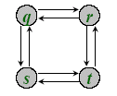
Optimal substructure
Longest path does not have optimal substructure.
Longest path from q to t: q → r → t.
Longest path from r to t: r → q → s → t, which is not contained in the longest path from q to t.
Difference between shortest and longest path:
  Shortest path has independent subproblem (solution to one problem does not depend on the other).
  If (p₁ = uw)(p₂ = wv) is a shortest path, then p₁ and p₂ cannot share any vertex other than w.

Slide 12
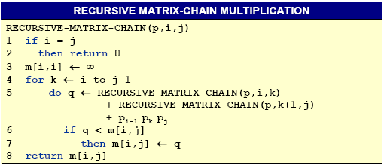
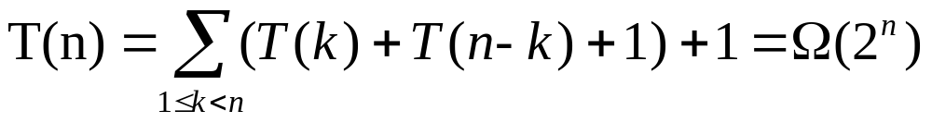
Overlapping Subproblem
To illustrate the overlapping-subproblem property, consider the MCM problem recursive algorithm.
See P346

Slide 13
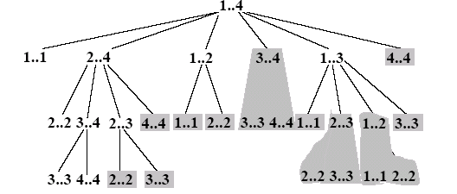
Elements of DP Algorithms
Overlapping subproblems
  The recursion tree for the computation of RECURSIVE-MATRIX-CHAIN(p, 1, 4).

Slide 14
Techniques for DP Algorithms
Reconstructing an optimal solution
  We often store which choice we made in each subproblem in a table.
    In assembly-line scheduling, we store in l_{i}[j] the station preceding S_{i,j}. Reconstructing the predecessor stations takes only O(1) time per station, even without the l_{i}[j].
    For matrix-chain multiplication, we maintain the s[i,j] table, after filling in the table m[i, j] which contains optimal subproblems costs. The table s[i, j] saves us a significant amount of work when reconstructing…. Why ?

Slide 15
Down Recursive VS Bottom Up DP
Bottom-up dynamic programming algorithm
  More efficient
    regular pattern of table access can be exploited to reduce time or space
    take advantage of the overlapping-subproblems property.
Top-down recursive algorithm
    repeatedly resolve each subproblem each time it appears in the recursion tree.
    recursion overhead
    Only work when the total number of subproblems in the recursion is small.

Slide 16
Memoization
A variation of dynamic programming
  offers the efficiency of the usual dynamic programming approach while maintaining a top-down strategy.
Ideas:
  to memoize the natural, but inefficient , recursive algorithm.
  A memoized recursive algorithm maintains an entry in a table for the solution to each subproblem.
  Initially contain a special value to indicate that the entry has yet to be filled in. when the subproblem is first encountered during the execution of the recursive algorithm, its solution is computed and then stored in the table.

Slide 17
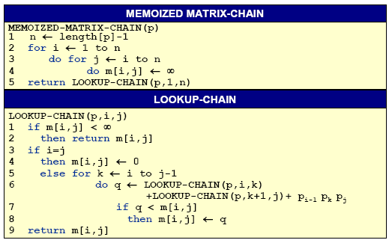
Memoized ver. of Recursive-Matrix-Chain

Slide 18
Top Down Memoi. VS Bottom Up DP
Bottom-up dynamic programming
  all subproblems must be solved
  regular pattern of table access can be exploited to reduce time or space
Top-down + memoization
  solve only subproblems that are definitely required
  recursion overhead
Both methods solve the matrix-chain multiplication problem in O(n³) and take advantage of the overlapping-subproblems property.

Slide 19
Longest Common Subsequence
In biological applications, we often want to compare the DNA of two (or more) different organisms.
A strand of DNA consists of a string of molecules called bases, where the possible bases are adenine, guanine, cytosine, and thymine (A, G, C, T).
Comparison of two DNA strings
S₁ = ACCGGTCGAGTGCGCGGAAGCCGGCCGAA
S₂ = GTCGTTCGGAATGCCGTTGCTCTGTAAA
S₃ = GTCGTCGGAAGCCGCCGAA
Comparison of two DNA strings
S₁ = ACCGGTCGAGTGCGCGGAAGCCGGCCGAA
S₂ = GTCGTTCGGAATGCCGTTGCTCTGTAAA
Notes:
strand：绳、线之一股, 线, 绳, 串
molecule：分子

Slide 20
Longest Common Subsequence
Similarity can be defined in different ways:
-- Two DNA strands are similar if one is a substring of the other.
-- Two strands are similar if the number of changes needed to turn one into the other is small.
-- There is a third strand S₃ in which the bases in S₃ appear in each of S₁ and S₂; these bases must appear in the same order, but not necessarily consecutively. The longer the strand S₃ we can find, the more similar S₁ and S₂ are. (we focus on this)

Slide 21
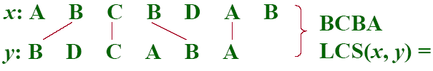
Dynamic programming for LCS
Longest common subsequence (LCS)
-- Given two sequences x[1..m] and y[1..n], find a longest subsequence common to then both.
“a” not “the”
Functional notation,
but not a function

Slide 22
Brute-force LCS algorithm
Check every subsequence of x[1..m] to see if it is also a subsequence of y[1..n].
Analysis
-- Checking = O(n) time per subsequence.
-- 2^{m} subsequences of x (each bit-vector of length m determines a distinct subsequence of x).
-- Worst-case running time = O(n2^{m})
= exponential time

Slide 23
Towards a better algorithm
Simplification:
1. Look at the length of a longest-common subsequence
2. Extend the algorithm to find the LCS itself.
Notation: Denote the length of a sequence s by |s|.
Strategy: Consider prefixes of x and y.
-- Define c[i,j] = |LCS(x[1..i],y[1..j]|
-- Then, c[m,n] = |LCS(x,y)|

Slide 24
Simple Review
Elements of DP Algorithms
  Optimal substructure
  Overlapping Subproblem
  Memoization
Longest Common Subsequence

Slide 25
Dynamic programming for LCS
Longest common subsequence (LCS)
-- Given two sequences x[1..m] and y[1..n], find a longest subsequence common to then both.
“a” not “the”
Functional notation,
but not a function

Slide 26
Brute-force LCS algorithm
Check every subsequence of x[1..m] to see if it is also a subsequence of y[1..n].
Analysis
-- Checking = O(n) time per subsequence.
-- 2^{m} subsequences of x (each bit-vector of length m determines a distinct subsequence of x).
-- Worst-case running time = O(n2^{m})
= exponential time

Slide 27
Towards a better algorithm
Simplification:
1. Look at the length of a longest-common subsequence
2. Extend the algorithm to find the LCS itself.
Notation: Denote the length of a sequence s by |s|.
Strategy: Consider prefixes of x and y.
-- Define c[i,j] = |LCS(x[1..i],y[1..j]|
-- Then, c[m,n] = |LCS(x,y)|

Slide 28
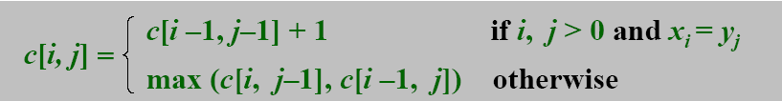
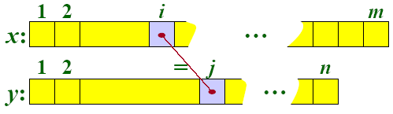
Recursive formulation
Theorem.
Proof. Case x[i] = y[j]:
Let z[1..k] = LCS(x[1..i],y[1..j]), where c[i,j] = k. Then z[k]=x[i], or else z could be extended. Thus, z[1..k-1] = is CS of x[1..i-1] and y[1..j-1]

Slide 29
Proof (continued)
Claim:z[1..k-1] = LCS(x[1..i-1],y[1..j-1]).
Suppose w is a longer CS of x[1..i-1] and y[1..j-1], that is, |w|>k-1. Then, cut and paste: |w||z[k]| (w concatenated with z[k]) is a common subsequence of x[1..i] and y[1..j] with |w||z[k]|>k. Contradiction, proving the claim.
Thus, c[i-1,j-1] = k – 1, which implies that c[i,j] = c[i-1,j-1] + 1
Other cases are similar.

Slide 30
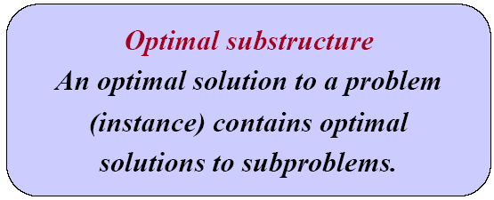
Dynamic-programming hallmark#1
If z=LCS(x,y), then any prefix of z is an LCS of a prefix of x and a prefix of y.

Slide 31
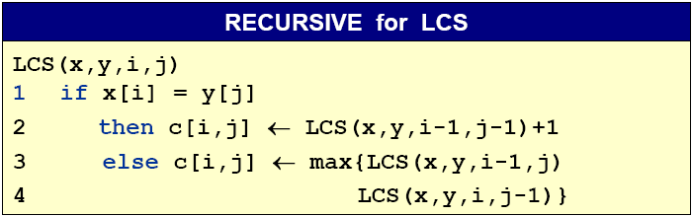
Recursive algorithm for LCS
Worst-case: x[i] ≠y[j], in which case the algorithm evaluates two subproblems, each with only one parameter decremented.

Slide 32
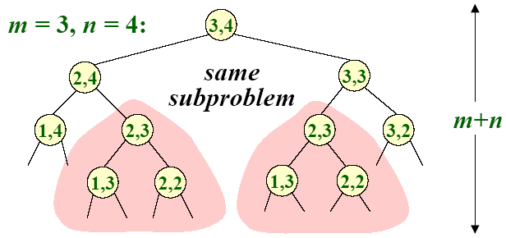
Recursive Tree
Height = m + n → work potentially exponential, but we’re solving subproblems already solved

Slide 33
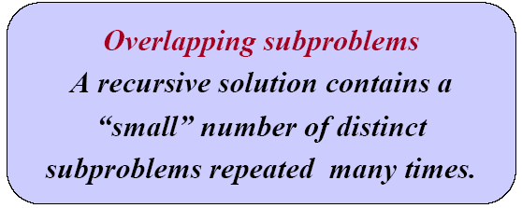
Dynamic-programming hallmark#2
The number of distinct LCS subproblems for two strings m and n is only mn.

Slide 34
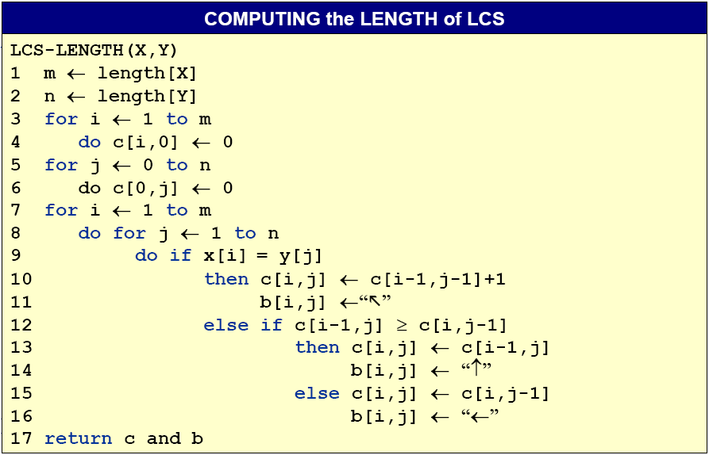
Dynamic-programming algorithm
 | 0 | 1 | 2 | 3 | 4 | 5
0
1
2
3
4
0 | 0 | 0 | 0 | 0 | 0
0
0
0
0

Slide 35
Computing the length of an LCS
The sequences are X=<A,B,C,B,D,A,B> and Y=<B,D,C,A,B,A>
 | j | 0 | 1 | 2 | 3 | 4 | 5 | 6
i |  | y_{i} | B | D | C | A | B | A
0 | x_{i}
1 | A
2 | B
3 | C
4 | B
5 | D
6 | A
7 | B
Compute c[i,j] row by row for i=1..m, j=1..n. Time=Θ(mn)
0 | 0 | 0 | 0 | 0 | 0 | 0
0
0
0
0
0
0
0
0
0
0
1
1
1
1
1
1
1
2
2
Reconstruct LCS by tracing backwards.
Space = Θ(mn).
1
1
2
2
2
2
1
1
2
2
3
3
1
2
2
2
3
3
1
2
2
3
3
4
1
2
2
3
4
4

Slide 36
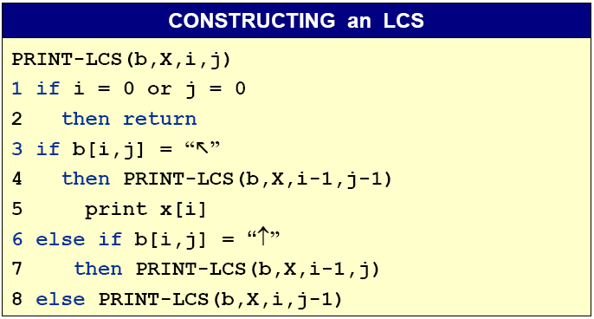
Constructing an LCS
The procedure takes time O(m+n)

Slide 37
Max Sum
Problem: you are given n integers (there may be negative ones but not all) a₁,a₂,…,a_{n}, determine i and j which maximize the sum from a_{i} to a_{j .}
Case: 6 integers: (-2，11，-4，13，-5，-2)
Ans: i = 2, j = 4, max sum is 20.

Slide 38
Max Sum - Brute-force
BRUTE-FORCE-MAX-SUM
int BruteForceMaxSum(int n, int a, int &besti, int &bestj){ int sum = -1; for(int i=1; i <= n; ++i){ for(int j=i; j <= n; ++j){ int thissum = 0; for(int k=i; k<=j; k++) thissum += a[k]; if(thissum > sum){ sum = thissum; besti = i, bestj = j; } } } return sum; }

Slide 39
Max Sum - A Better Algorithm
BETTER-MAX-SUM
int BetterMaxSum(int n, int a, int &besti, int &bestj){ int sum = -1; for(int i=1; i <= n; ++i){ int thissum = 0; for(int j=i; j <= n; ++j){ thissum += a[j]; if(thissum > sum){ sum = thissum; besti = i, bestj = j; } } } return sum; }

Slide 40
Max Sum - DP
Define b[j]=max(sum(i:j)), 1<=i<=j.
  max(b[k]),1<=k<=n is ms(1,n) , what we want.
b[j]=max( b[j-1]+a[j], a[j] ), 1<=j<=n.
DP-MAX-SUM
int DPMaxSum(int n, int a, int &besti, int &bestj){ int sum=a[1], b[1]=a[1]; for(int i=2; i <= n; ++i){ if(b[i-1]>0) b[i] = b[i-1]+a[i]; else b[i] = a[i]; if(b[i]>sum) sum = b[i]; } return sum; }

Slide 41
Max Sum - DP
Define b[j]=max(sum(i:j)), 1<=i<=j.
  max(b[k]),1<=k<=n is ms(1,n) , what we want.
b[j]=max( b[j-1]+a[j], a[j] ), 1<=j<=n.
DP-MAX-SUM
int DPMaxSum(int n, int a, int &besti, int &bestj){ int sum=0, b=0; for(int i=1; i <= n; ++i){ if(b>0) b += a[i]; else b = a[i]; if(b>sum) sum = b; } return sum; }

Slide 42
Homework
15.4-1

